Slide 1
Parallel Computing
杨广文
Institute of HPC
ygw@tsinghua.edu.cn
010-62798985O)
http://grid.tsinghua.edu.cn

Slide 2
Contents
Introduction to Parallel Computing
Parallel Programming Platforms
Principle of Parallel Algorithm Design
Basic Computation Operations
Analytical Modeling of Parallel Programs
Programming Using the Message-Passing Paradigm
Programming Shared Address Space Platforms
Dense Matrix Algorithms
Sorting Algorithms
Graph Algorithms
Search Algorithms for discrete Optimization Programming
Dynamic Programming
Fast Fourier Transform

Slide 3
Analytical Modeling of Parallel Systems

Slide 4
Topic Overview
Sources of Overhead in Parallel Programs
Performance Metrics for Parallel Systems
Effect of Granularity on Performance
Scalability of Parallel Systems
Minimum Execution Time and Minimum Cost-Optimal Execution Time
Asymptotic Analysis of Parallel Programs
Other Scalability Metrics

Slide 5
Analytical Modeling - Basics
A sequential algorithm is evaluated by its runtime (in general, asymptotic runtime as a function of input size).
The asymptotic runtime of a sequential program is identical on any serial platform.
The parallel runtime of a program depends on the input size, the number of processors, and the communication parameters of the machine.
An algorithm must therefore be analyzed in the context of the underlying platform.
A parallel system is a combination of a parallel algorithm and an underlying platform.

Slide 6
Analytical Modeling - Basics
A number of performance measures are intuitive.
Wall clock time - the time from the start of the first processor to the stopping time of the last processor in a parallel ensemble. But how does this scale when the number of processors is changed of the program is ported to another machine altogether?
How much faster is the parallel version? This begs the obvious followup question - whats the baseline serial version with which we compare? Can we use a suboptimal serial program to make our parallel program look
Raw FLOP count - What good are FLOP counts when they don’t solve a problem?

Slide 7
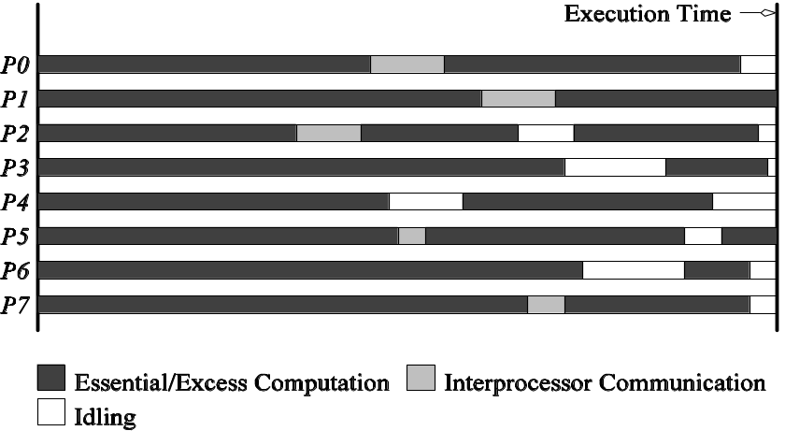
5.1 Sources of Overhead in Parallel Programs
If I use two processors, shouldnt my program run twice as fast?
No - a number of overheads, including wasted computation, communication, idling, and contention cause degradation in performance.
The execution profile of a hypothetical parallel program executing on eight processing elements. Profile indicates times spent performing computation (both essential and excess), communication, and idling.

Slide 8
Sources of Overheads in Parallel Programs
Interprocess interactions: Processors working on any non-trivial parallel problem will need to talk to each other.
Idling: Processes may idle because of load imbalance, synchronization, or serial components.
Excess Computation: This is computation not performed by the serial version. This might be because the serial algorithm is difficult to parallelize, or that some computations are repeated across processors to minimize communication.

Slide 9

5.2Performance Metrics for Parallel Systems

Slide 10
5.2.1Execution Time
Serial runtime of a program is the time elapsed between the beginning and the end of its execution on a sequential computer.
The parallel runtime is the time that elapses from the moment the first processor starts to the moment the last processor finishes execution.
We denote the serial runtime by T_{S} and the parallel runtime by T_{P} .

Slide 11
5.2.2 Total Parallel Overhead
Let T_{all} be the total time collectively spent by all the processing elements.
T_{S} is the serial time.
Observe that T_{all} - T_{S} is then the total time spend by all processors combined in non-useful work. This is called the total overhead.
The total time collectively spent by all the processing elements T_{all} = p T_{P}
  (p is the number of processors).
The overhead function (T_{o}) is therefore given by
T_{o} = p T_{P} - T_{S}

Slide 12
5.2.3 Speedup
What is the benefit from parallelism?
Speedup (S) is the ratio of the time taken to solve a problem on a single processor to the time required to solve the same problem on a parallel computer with p identical processing elements.

Slide 13
Performance Metrics: Example
Consider the problem of adding n numbers by using n processing elements.
If n is a power of 2, we can perform this operation in log n steps by propagating partial sums up a logical binary tree of processors.

Slide 14
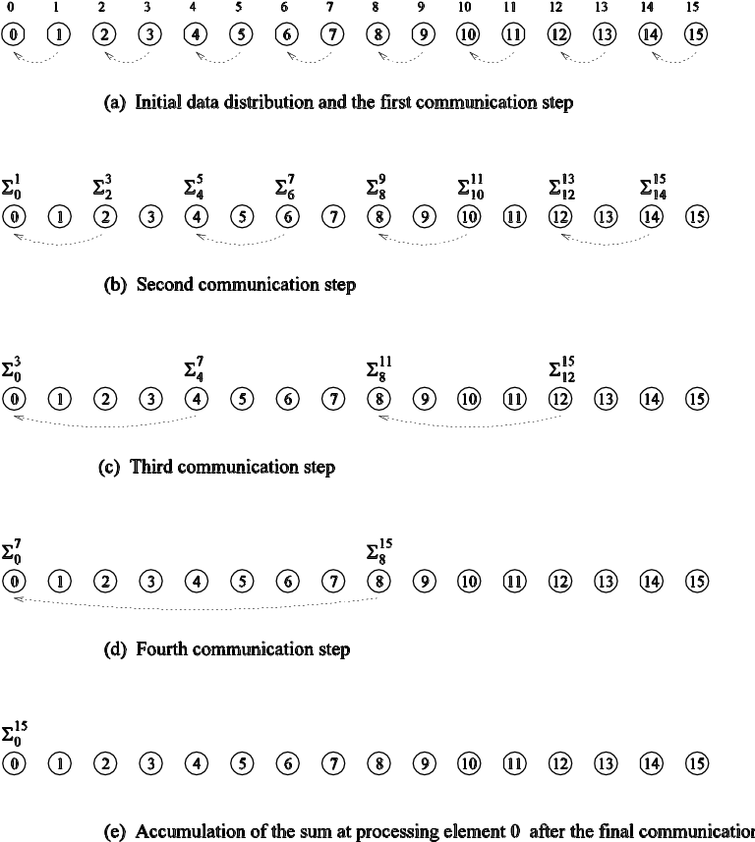
Performance Metrics: Example
Computing the globalsum of 16 partial sums using 16 processing elements . Σ^{j}_{i} denotes the sum of numbers with consecutive labels from i to j.

Slide 15
Performance Metrics: Example (continued)
If an addition takes constant time, say, t_{c} and communication of a single word
takes time t_{s} + t_{w} (constant time), we have the parallel time T_{P} = Θ (log n)
We know that T_{S} = Θ (n)
Speedup S is given by S = Θ (n / log n)

Slide 16
Performance Metrics: Speedup
For a given problem, there might be many serial algorithms available. These algorithms may have different asymptotic runtimes and may be parallelizable to different degrees.
For the purpose of computing speedup, we always consider the best sequential program as the baseline.

Slide 17
Performance Metrics: Speedup Example
Consider the problem of parallel bubble sort.
The serial time for bubblesort is 150 seconds.
The parallel time for odd-even sort (efficient parallelization of bubble sort) is 40 seconds.
The speedup would appear to be 150/40 = 3.75.
But is this really a fair assessment of the system?
What if serial quicksort only took 30 seconds? In this case, the speedup is 30/40 = 0.75. This is a more realistic assessment of the system.

Slide 18
Performance Metrics: Speedup Bounds
Speedup can be as low as 0 (the parallel program never terminates).
Speedup, in theory, should be upper bounded by p - after all, we can only expect a p-fold speedup if we use times as many resources.
A speedup greater than p is possible only if each processing element spends less than time T_{S} / p solving the problem.
In this case, a single processor could be time slided to achieve a faster serial program, which contradicts our assumption of fastest serial program as basis for speedup.

Slide 19
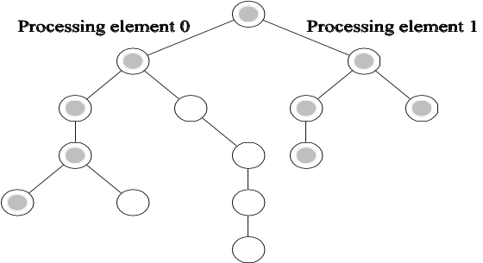
Performance Metrics: Superlinear Speedups
One reason for superlinearity is that the parallel version does less work than corresponding serial algorithm.
Searching an unstructured tree for a node with a given label, `S', on two processing elements using depth-first traversal. The two-processor version with processor 0 searching the left subtree and processor 1 searching the right subtree expands only the shaded nodes before the solution is found. The corresponding serial formulation expands the entire tree. It is clear that the serial algorithm does more work than the parallel algorithm.

Slide 20
Performance Metrics: Superlinear Speedups
Resource-based superlinearity: The higher aggregate cache/memory bandwidth can result in better cache-hit ratios, and therefore superlinearity.
Example: A processor with 64KB of cache yields an 80% hit ratio. If two processors are used, since the problem size/processor is smaller, the hit ratio goes up to 90%. Of the remaining 10% access, 8% come from local memory and 2% from remote memory.
If DRAM access time is 100 ns, cache access time is 2 ns, and remote memory access time is 400ns, this corresponds to a speedup of 2.43!

Slide 21
  主要有三种加速比性能定律:
    Amdahl定律:
    固定计算负载的加速比性能模型
    Gustafson定律:
    固定时间的加速比性能模型
    Sun和Ni定律:
    受限于存储器的加速比性能模型

Slide 22
主要参数说明
    p 并行系统中处理器数目
    W 问题规模(通常也叫计算负载,工作负载,定 义为问题得总计算量)
    Ws 应用程序中的串行分量
    Wp W中可并行化部分
    f 串行分量得比例,即f=Ws/W
    Ts 串行部分得执行时间
    Tp 并行部分得执行时间
    S 加速比
    E 效率

Slide 23
    Amdahl定律的基本出发点:
    对于许多的科学计算,实时性要求很高,即在这类应用中计算时间是个关键性因素,而计算负载是固定不变的.为此,在一定的计算负载下,为满足实时性的要求,可以通过增加处理器数目的方法来减少运行时间,提高计算速度
    (2) 因为固定的计算负载可以分布在多个处理器上,这样增加了处理器就加快了执行速度,从而达到加速的目的.

Slide 24
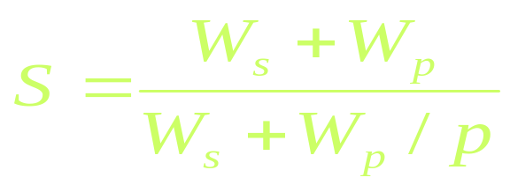
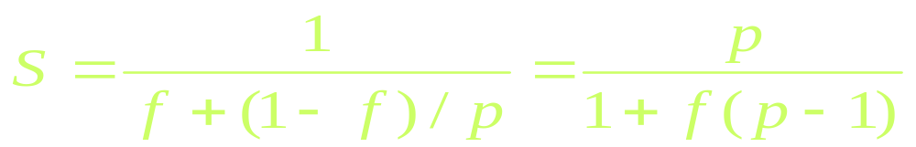
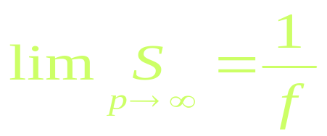
  在以上动机的推动下,1967年Amdahl推导出了固定负载情况下的加速比公式:
  由于W=Ws+Wp,上式右边分母同除以W,则
  不管采用多少处理机，可望达到的最好加速比：

Slide 25
  这就是著名的Amdahl加速定律，它意味着随着处理器数目的无限增大，并行系统所能达到的加速比存在上限，且为一个常数1/f，这个常数只取决于应用本身的性质。它带来了两种影响:
  1.劝阻制造商生产大规模并行计算机。
  2.研究并行编译器，以降低f的值，从而提高系统的性能。
  下面我们用图来更形象地表示出其几何意义.

Slide 26
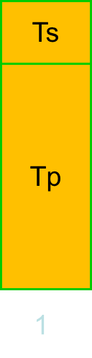
Workload
Execution Time
Ws
Ws
Ws
Ws
Wp
Wp
Wp
Wp
Ts
Ts
Tp
Ts
Tp
Tp
1
2
3
4
N
2
3
4
N
固定负载
执行时间随N增加而减少
固定负载加速比模型下的负载和执行时间情况

Slide 27
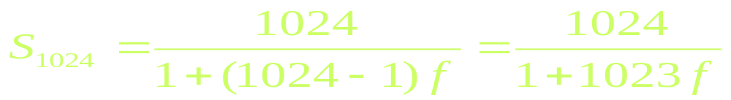

当处理器数目p=1024，加速比S随f变化的情况如下：
得出曲线如下图：
Sn
1024
91
48
31
10
24
α

Slide 28
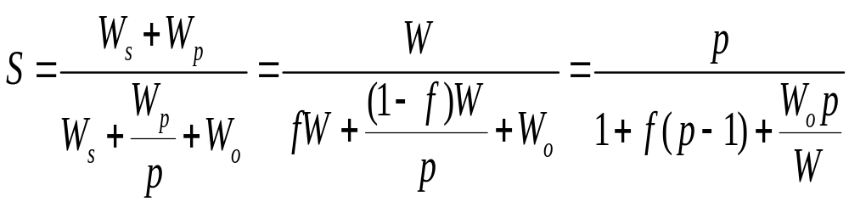
  实际上并行加速比不仅受限于程序的串行分量的比例，而且也受并行程序运行时的额外开销的影响。如果考虑到这部分因素的影响，令W_{o}为额外开销，那么上面的公式应该修改为：

Slide 29
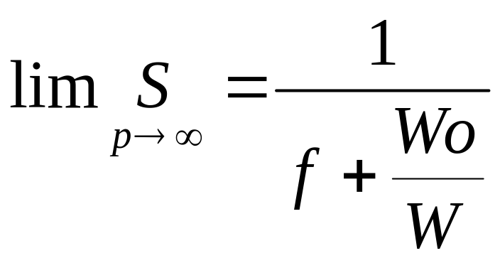
在这种情况下,加速比的极限为:
结论:
并行程序中的串行分量比例和并行额外开销越大,则加速比越小

Slide 30
Gustafson定律的基本出发点是：
对于很多大型计算，精度要求很高，即在此类应用中精度是一个关键因素，而计算时间是固定不变的。此时为了提高精度，必须加大计算量，相应的也必须增加处理器的数目来完成这部分计算，以保持计算时间不变；
(2) 除非学术研究，在实际应用中没有必要固定工作负载而使计算程序运行在不同数目的处理器上，增多处理器必须相应的增大问题规模才有实际的意义。因此研究在给定的时间内用不同数目的处理器能够完成多大的计算量是并行计算中一个很实际的问题。

Slide 31
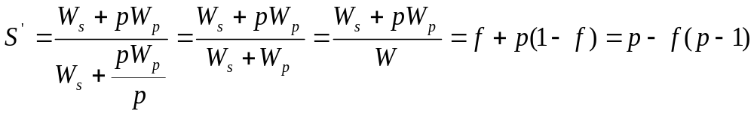
(3) 对大多数问题，问题规模的改变只会改变计算中并行计算量，而不会改变串行计算量。
从这些动机出发，Gustafson在1987年提出了变问题规模的加速比模型：

Slide 32
  在固定时间加速比模型下，负载和执行时间随系统中处理机数目n变化的情况如下图：
Workload
Execution Time
Ws
Ts
Ts
Ts
Ts
Ws
Wp
Tp
Tp
Tp
Tp
Ws
Wp
Ws
Wp
Wp
1
2
3
4
N
1
2
3
4
N
并行负载不断增加
执行时间固定
固定时间加速比模型下的负载和执行时间情况

Slide 33

增大问题规模的办法使所有处理机保持忙碌状态，在问题扩大到与可用的计算能力匹配时，程序中的顺序部分就不再是瓶颈了。当处理器数目p=1024，加速比S随f变化的情况如下：
Sn’
1014
1024
993
1004
983
f

Slide 34
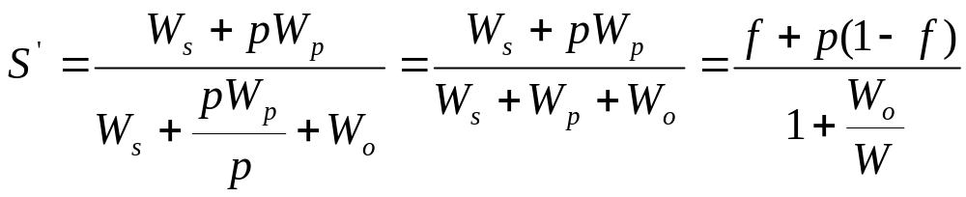
同样的，当考虑到并行程序运行时的额外开销时，Gustafson定律应该修改为：
注意，W_{o}是p的函数，它可能会随着p的改变而改变。要到达一般化的Gustafson定律所描述的线性加速比，当p改变时，必须要控制额外开销的增长，这在实际中往往是非常困难的。

Slide 35
  Sun和Ni定律的基本出发点
    1993年，由Sun和Ni提出。
    大型科学计算和工程设计需要较大的存储空间，许多应用问题是存储器受限，而不是CPU受限或者I/O受限。
    比如：在分布存储系统中常遇到，总存储容量随结点数线性增加，许多节点集合起来解一个大题。
    基本思想：要在存储空间有限条件下解尽可能大的问题，这同样需要扩展工作负载，才能提供较高的加速比、较高的精度和较好的资源利用率。

Slide 36
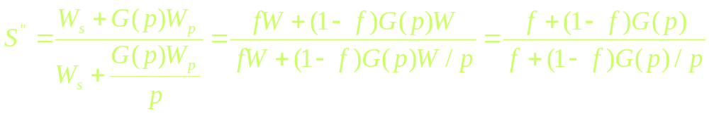
  加速比可以表示如下：
  其中:
  G(p)反映的是存储容量增加p倍时并行工作负载增加的倍数。

Slide 37
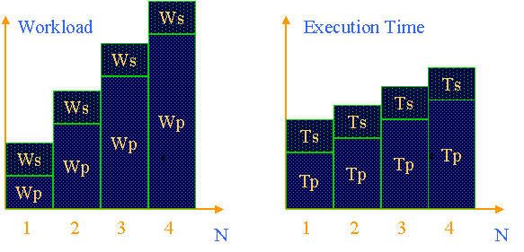
Sun和Ni定律的几何意义可以清楚的用下面的图来表示：

Slide 38
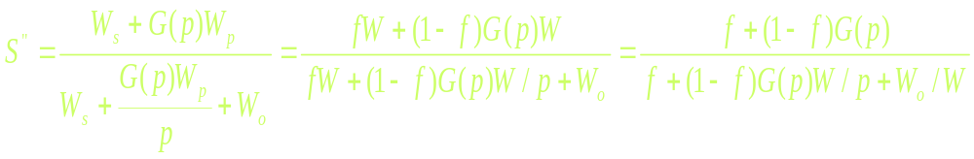
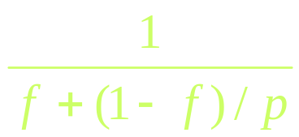
如果考虑到并行程序运行时的额外开销W_{o}，则上面的公式应该作相应的修改：
当G(p)=1时，它变为 这就是Amdahl定律，当G(p)=p时，它变为f+p(1-f)，这就是Gustafson定律，当G(p)>p时，它相应于计算负载比存储要求增加得快，此时Sun和Ni定律指出的加速比比Amdahl和Gustafson定律指出的都要高。

Slide 39


5.2.4 Efficiency
Efficiency is a measure of the fraction of time for which a processing element is usefully employed
Mathematically, it is given by
=
Following the bounds on speedup, efficiency can be as low as 0 and as high as 1.

Slide 40

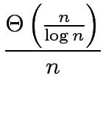

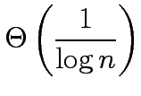
Performance Metrics: Efficiency Example
The speedup of adding numbers on processors is given by
Efficiency is given by
=
=

Slide 41
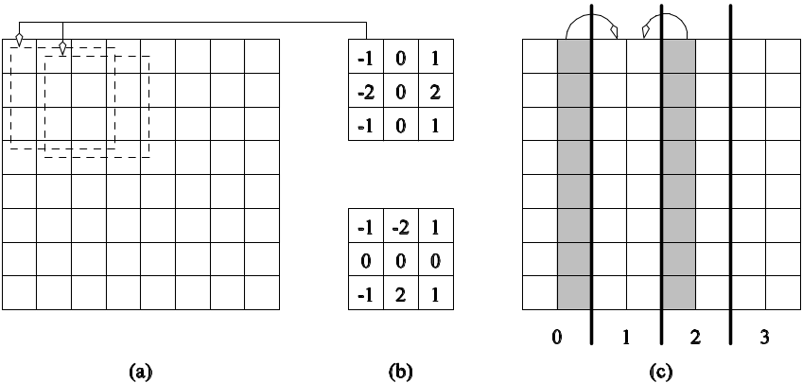
Parallel Time, Speedup, and Efficiency Example
Consider the problem of edge-detection in images. The problem requires us to apply a 3 x 3 template to each pixel. If each multiply-add operation takes time t_{c}, the serial time for an n x n image is given by T_{S}= t_{c} n².
Example of edge detection: (a) an 8 x 8 image; (b) typical templates for detecting edges; and (c) partitioning of the image across four processors with shaded regions indicating image data that must be communicated from neighboring processors to processor 1.

Slide 42
Parallel Time, Speedup, and Efficiency Example (continued)
One possible parallelization partitions the image equally into vertical segments, each with n² / p pixels.
The boundary of each segment is 2n pixels. This is also the number of pixel values that will have to be communicated. This takes time 2(t_{s} + t_{w}n).
Templates may now be applied to all n² / p pixels in time
T_{S} = 9 t_{c}n² / p.

Slide 43
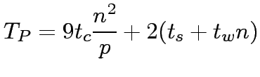
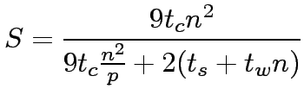
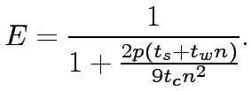
Parallel Time, Speedup, and Efficiency Example (continued)
The total time for the algorithm is therefore given by:
The corresponding values of speedup and efficiency are given by:

Slide 44
5.2.5 Cost of a Parallel System
Cost is the product of parallel runtime and the number of processing elements used (p x T_{P} ).
Cost reflects the sum of the time that each processing element spends solving the problem.
A parallel system is said to be cost-optimal if the cost of solving a problem on a parallel computer is asymptotically identical to serial cost.
Since E = T_{S} / p T_{P}, for cost optimal systems, E = O(1).
Cost is sometimes referred to as work or processor-time product.

Slide 45
Cost of a Parallel System: Example
Consider the problem of adding numbers on processors.
We have, T_{P} = log n (for p = n).
The cost of this system is given by p T_{P} = n log n.
Since the serial runtime of this operation is Θ(n), the algorithm is not cost optimal.

Slide 46
Impact of Non-Cost Optimality
Consider a sorting algorithm that uses n processing elements to sort the list in time (log n)².
Since the serial runtime of a (comparison-based) sort is n log n, the speedup and efficiency of this algorithm are given by n / log n and 1 / log n, respectively.
The p T_{P} product of this algorithm is n (log n)².
This algorithm is not cost optimal but only by a factor of log n.
If p < n, assigning n tasks to p processors gives
T_{P} = n (log n)² / p .
The corresponding speedup of this formulation is p / log n.
This speedup goes down as the problem size n is increased for a given p !

Slide 47
5.3 Effect of Granularity on Performance
Often, using fewer processors improves performance of parallel systems.
Using fewer than the maximum possible number of processing elements to execute a parallel algorithm is called scaling down a parallel system.
A naive way of scaling down is to think of each processor in the original case as a virtual processor and to assign virtual processors equally to scaled down processors.
Since the number of processing elements decreases by a factor of n / p, the computation at each processing element increases by a factor of n / p.
The communication cost should not increase by this factor since some of the virtual processors assigned to a physical processors might talk to each other. This is the basic reason for the improvement from building granularity.

Slide 48
Building Granularity: Example
Consider the problem of adding n numbers on p processing elements such that p < n and both n and p are powers of 2.
Use the parallel algorithm for n processors, except, in this case, we think of them as virtual processors.
Each of the p processors is now assigned n / p virtual processors.
The first log p of the log n steps of the original algorithm are simulated in (n / p) log p steps on p processing elements.
Subsequent log n - log p steps do not require any communication.

Slide 49
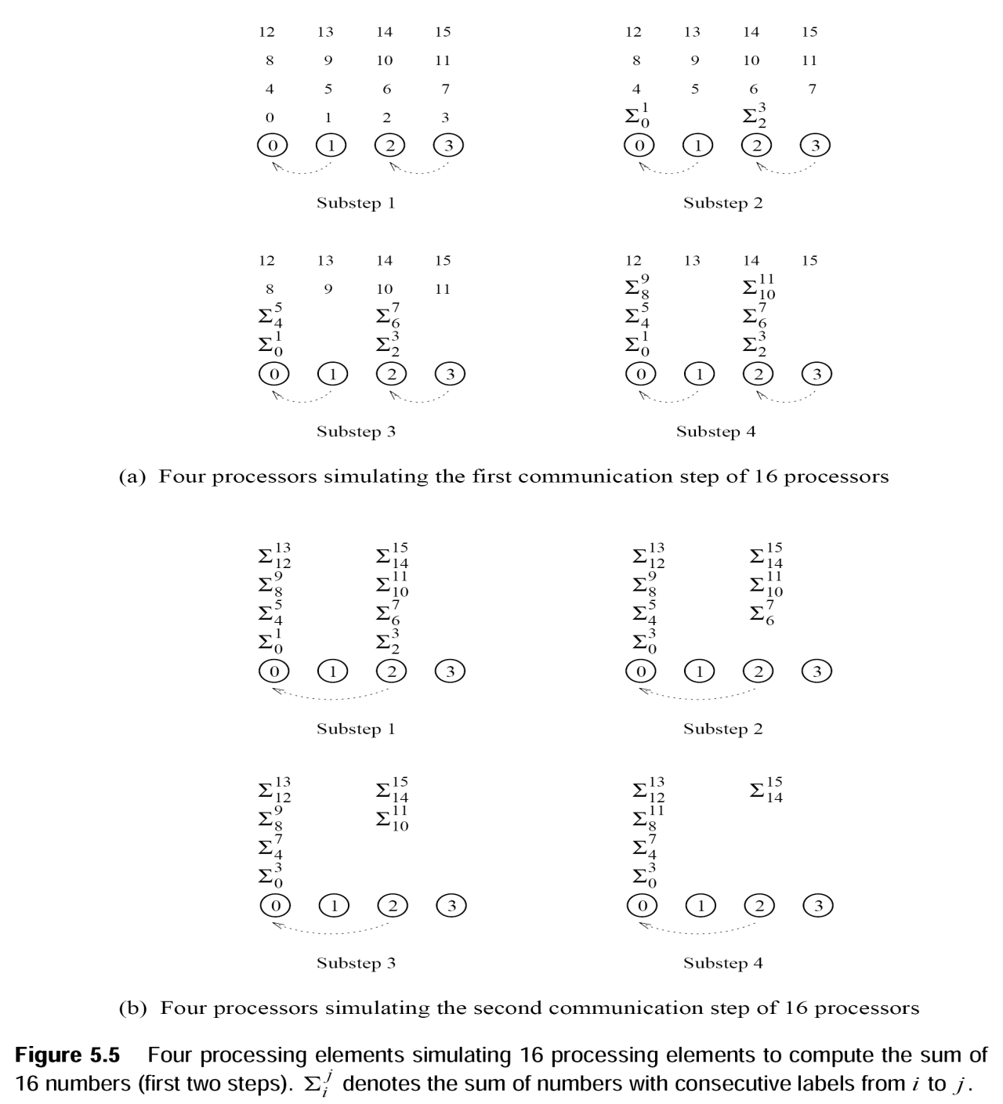

Slide 50
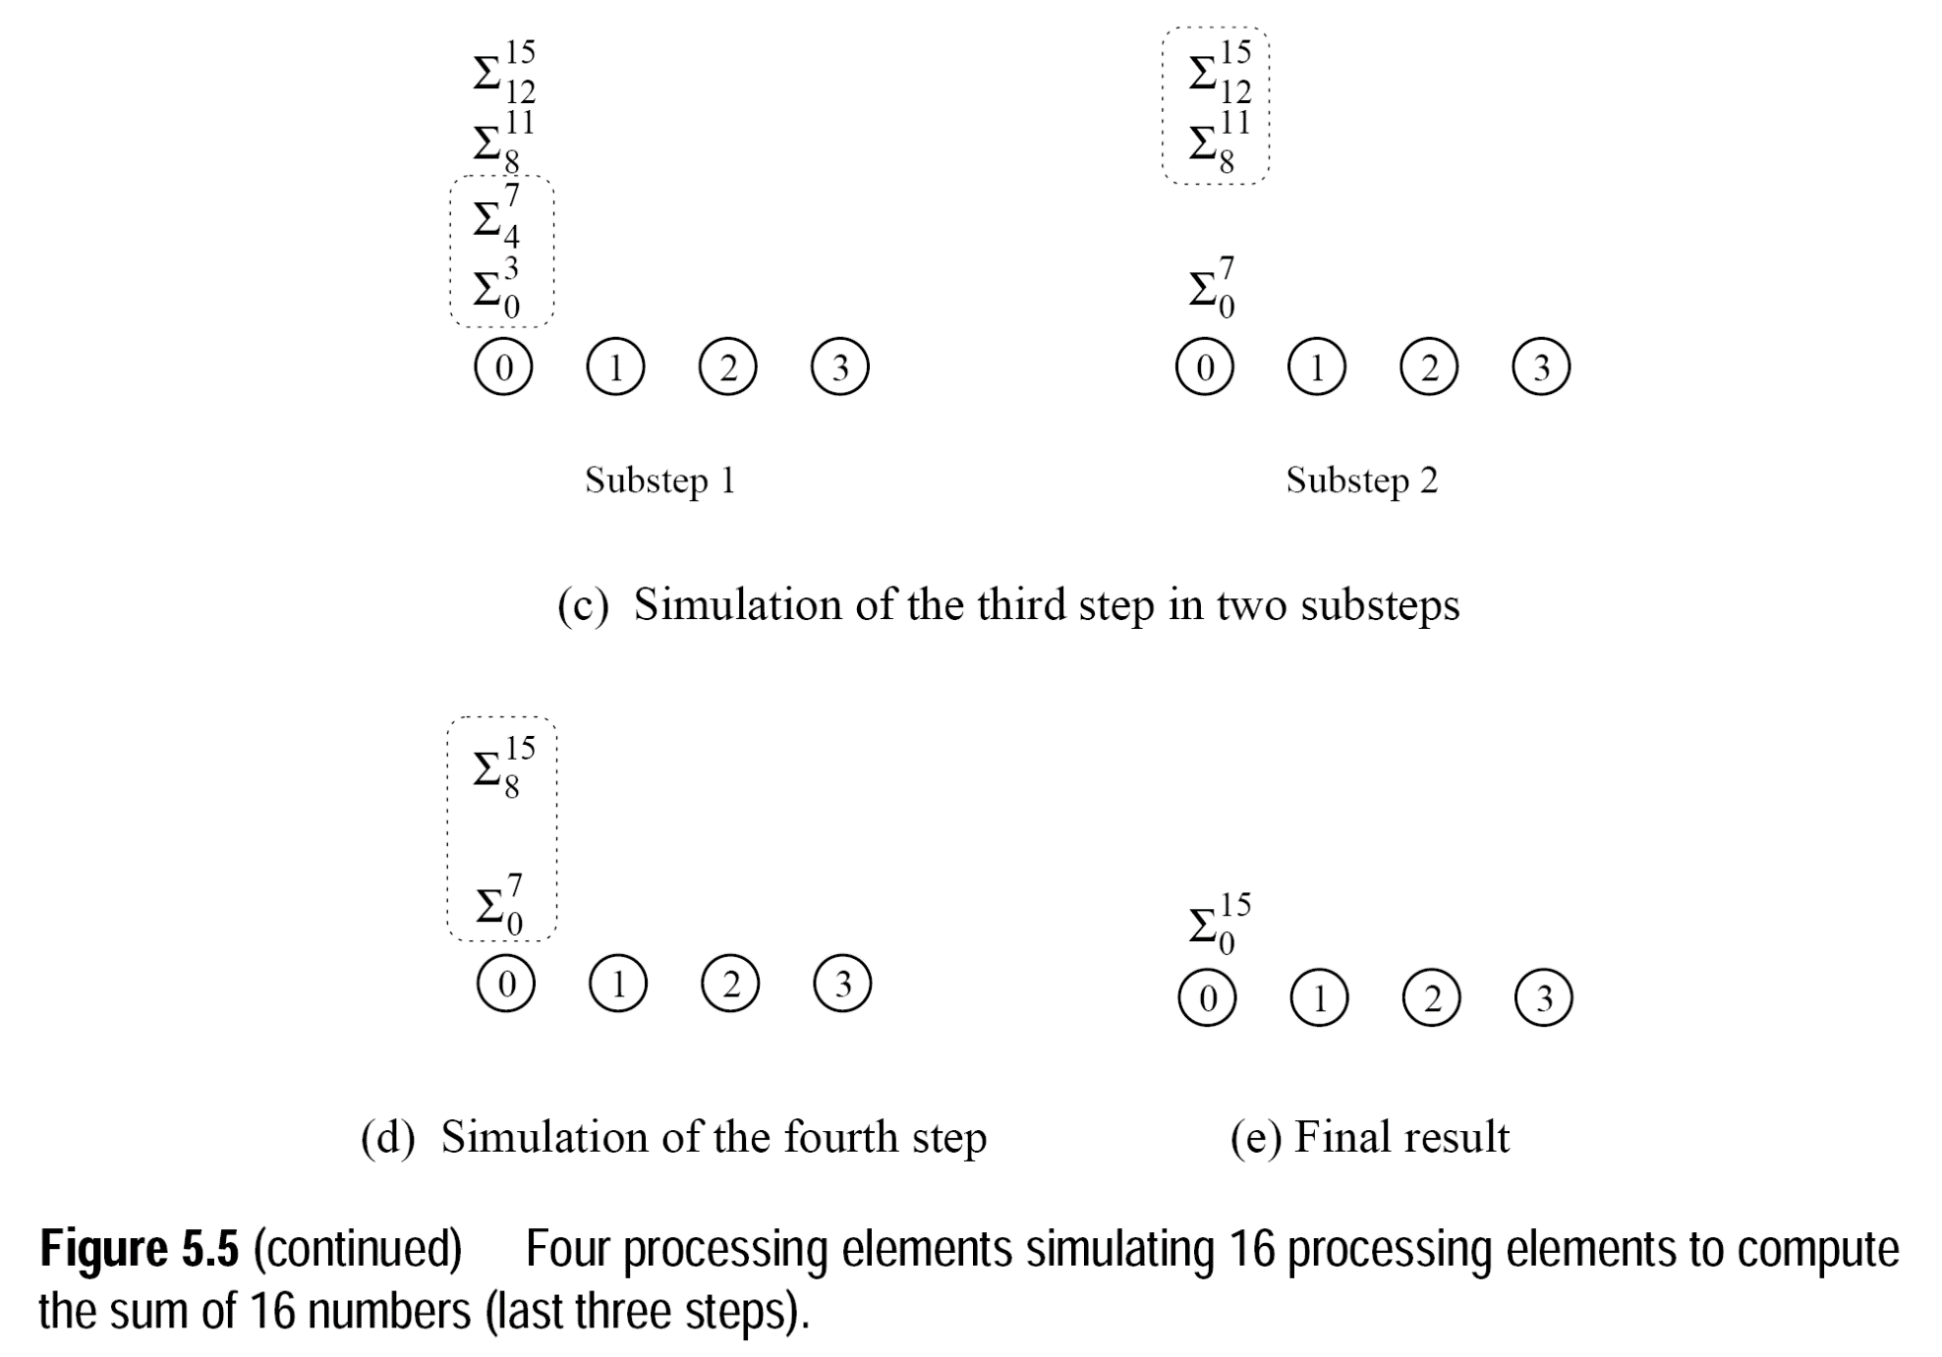

Slide 51
Building Granularity: Example (continued)
The overall parallel execution time of this parallel system is
Θ ( (n / p) log p).
The cost is Θ (n log p), which is asymptotically higher than the Θ (n) cost of adding n numbers sequentially. Therefore, the parallel system is not cost-optimal.

Slide 52
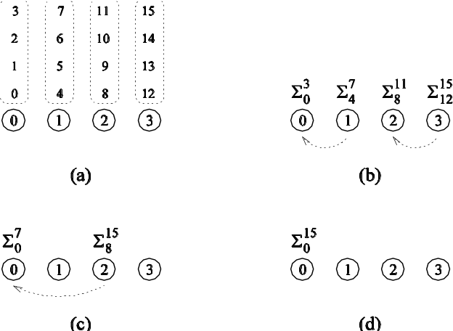
Building Granularity: Example (continued)
Can we build granularity in the example in a cost-optimal fashion?
Each processing element locally adds its n / p numbers in time Θ (n / p).
The p partial sums on p processing elements can be added in time Θ(logp).
A cost-optimal way of computing the sum of 16 numbers using four processing elements.

Slide 53



Building Granularity: Example (continued)
The parallel runtime of this algorithm is
The cost is
This is cost-optimal, as long as
(the cost is Θ (n))

Slide 54
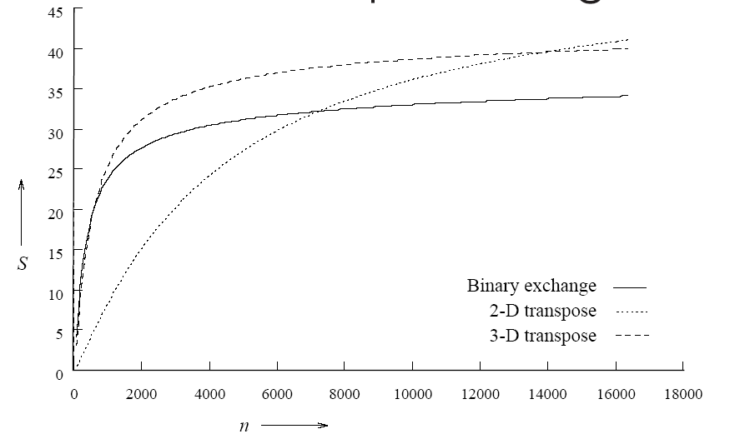
5.4 Scalability of Parallel Systems
How do we extrapolate performance from small problems and small systems to larger problems on larger configurations?
Consider three parallel algorithms for computing an n-point Fast Fourier Transform (FFT) on 64 processing elements.
A comparison of the speedups obtained by the binary-exchange, 2-D transpose and 3-D transpose algorithms on 64 processing elements with t_{c} = 2, t_{w} = 4, t_{s} = 25, and t_{h} = 2.
Clearly, it is difficult to infer scaling characteristics from observations on small datasets on small machines.

Slide 55
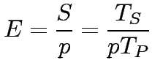

5.4.1 Scaling Characteristics of Parallel Programs
The efficiency of a parallel program can be written as:
or
The total overhead function T_{o} is an increasing function of p .

Slide 56
Scaling Characteristics of Parallel Programs
For a given problem size (i.e., the value of T_{S} remains constant), as we increase the number of processing elements, T_{o} increases.
The overall efficiency of the parallel program goes down. This is the case for all parallel programs.

Slide 57




Scaling Characteristics of Parallel Programs: Example
Consider the problem of adding numbers on processing elements.
We have seen that:
=
=
=

Slide 58
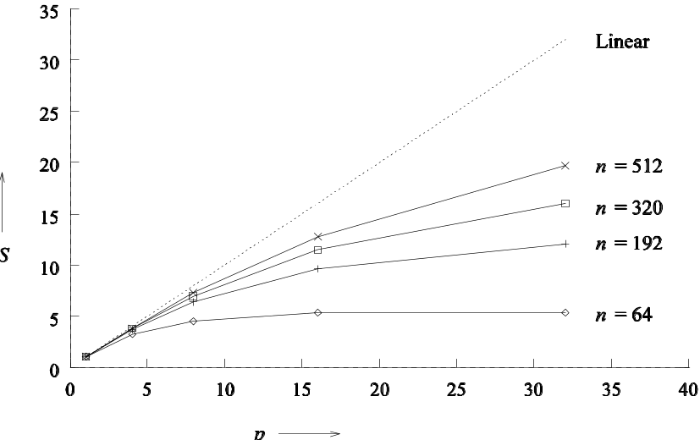
Scaling Characteristics of Parallel Programs: Example (continued)
Plotting the speedup for various input sizes gives us:
Speedup versus the number of processing elements for adding a list of numbers.
Speedup tends to saturate and efficiency drops as a consequence of Amdahl's law

Slide 59
Scaling Characteristics of Parallel Programs
Total overhead function T_{o} is a function of both problem size T_{s} and the number of processing elements p.
In many cases, T_{o} grows sublinearly with respect to T_{s}.
In such cases, the efficiency increases if the problem size is increased keeping the number of processing elements constant.
For such systems, we can simultaneously increase the problem size and number of processors to keep efficiency constant.
We call such systems scalable parallel systems.

Slide 60
Scaling Characteristics of Parallel Programs
Recall that cost-optimal parallel systems have an efficiency of Θ(1).
Scalability and cost-optimality are therefore related.
A scalable parallel system can always be made cost-optimal if the number of processing elements and the size of the computation are chosen appropriately.

Slide 61
5.4.2 Isoefficiency Metric of Scalability
For a given problem size, as we increase the number of processing elements, the overall efficiency of the parallel system goes down for all systems.
For some systems, the efficiency of a parallel system increases if the problem size is increased while keeping the number of processing elements constant.

Slide 62
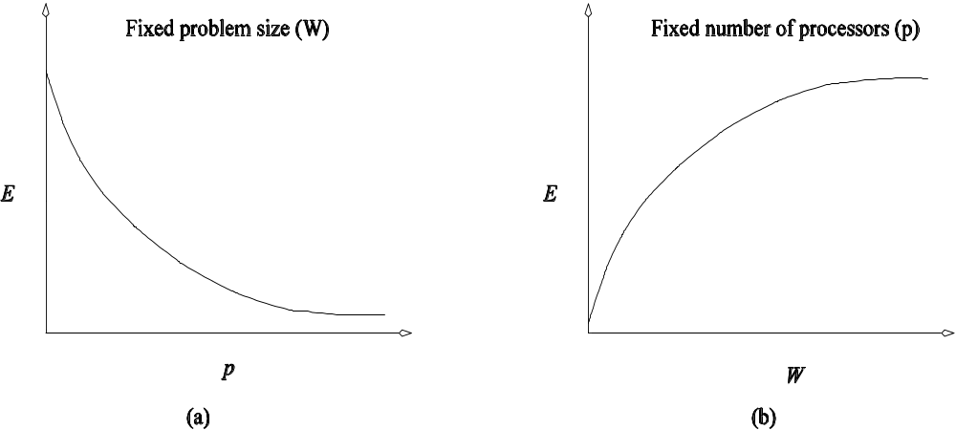
Isoefficiency Metric of Scalability
Variation of efficiency: (a) as the number of processing elements is increased for a given problem size; and (b) as the problem size is increased for a given number of processing elements. The phenomenon illustrated in graph (b) is not common to all parallel systems.

Slide 63
Isoefficiency Metric of Scalability
What is the rate at which the problem size must increase with respect to the number of processing elements to keep the efficiency fixed?
This rate determines the scalability of the system. The slower this rate, the better.
Before we formalize this rate, we define the problem size W as the asymptotic number of operations associated with the best serial algorithm to solve the problem.

Slide 64

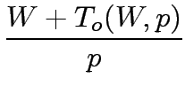

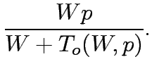

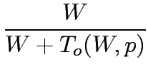

Isoefficiency Metric of Scalability
We can write parallel runtime as:
The resulting expression for speedup is
Finally, we write the expression for efficiency as

Slide 65

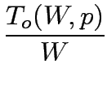
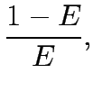

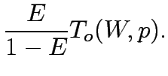

Isoefficiency Metric of Scalability
For scalable parallel systems, efficiency can be maintained at a fixed value (between 0 and 1) if the ratio T_{o} / W is maintained at a constant value.
For a desired value E of efficiency,
If K = E / (1 – E) is a constant depending on the efficiency to be maintained, since T_{o} is a function of W and p, we have

Slide 66
Isoefficiency Metric of Scalability
The problem size W can usually be obtained as a function of p by algebraic manipulations to keep efficiency constant.
This function is called the isoefficiency function.
This function determines the ease with which a parallel system can maintain a constant efficiency and hence achieve speedups increasing in proportion to the number of processing elements

Slide 67


Isoefficiency Metric: Example
Isoefficiency function of adding numbers
The overhead function for the problem of adding n numbers on p processing elements is approximately 2p log p .
Substituting T_{o} by 2p log p , we get
=
Thus, the asymptotic isoefficiency function for this parallel system is
.
If the number of processing elements is increased from p to p’, the problem size (in this case, n ) must be increased by a factor of (p’ log p’) / (p log p) to get the same efficiency as on p processing elements.

Slide 68






Isoefficiency Metric: Example
Consider a more complex example (hypothetical parallel system) where
= + Kp^{3/4}W^{3/4}
Using only the first term of T_{o ,}we get
=
Using only the second term, the following relation between W and p:
The larger of these two asymptotic rates determines the isoefficiency. This is given by Θ(p³)

Slide 69

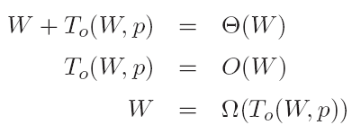
5.4.3 Cost-Optimality and the Isoefficiency Function
A parallel system is cost-optimal if and only if
From this, we have:
If we have an isoefficiency function f(p), then it follows that the relation W = Ω(f(p)) must be satisfied to ensure the cost-optimality of a parallel system as it is scaled up.

Slide 70
5.4.4 Lower Bound on the Isoefficiency Function
For a problem consisting of W units of work, no more than W processing elements can be used cost-optimally.
The problem size must increase at least as fast as Θ(p) to maintain fixed efficiency; hence, Ω(p) is the asymptotic lower bound on the isoefficiency function.

Slide 71
5.4.5.Degree of Concurrency and the Isoefficiency Function
The maximum number of tasks that can be executed simultaneously at any time in a parallel algorithm is called its degree of concurrency.
If C(W) is the degree of concurrency of a parallel algorithm, then for a problem of size W, no more than C(W) processing elements can be employed effectively.

Slide 72
Degree of Concurrency and the Isoefficiency Function: Example
Consider solving a system of equations in variables by using Gaussian elimination (W = Θ(n³))
The n variables must be eliminated one after the other, and eliminating each variable requires Θ(n²) computations.
At most Θ(n²) processing elements can be kept busy at any time.
Since W = Θ(n³) for this problem, the degree of concurrency C(W) is Θ(W^{2/3}) .
Given p processing elements, the problem size should be at least Ω(p^{3/2}) to use them all.

Slide 73

5.5 Minimum Execution Time and Minimum Cost-Optimal Execution Time
Often, we are interested in the minimum time to solution.
We can determine the minimum parallel runtime T_{P}^{min} for a given W by differentiating the expression for T_{P} w.r.t. p and equating it to zero.
=0
If p₀ is the value of p as determined by this equation, T_{P}(p₀) is the minimum parallel time.

Slide 74



Minimum Execution Time: Example
Consider the minimum execution time for adding n numbers.
=
Setting the derivative w.r.t. p to zero, we have p = n/ 2 . The corresponding runtime is
=
(One may verify that this is indeed a min by verifying that the second derivative is positive).
Note that at this point, the formulation is not cost-optimal.

Slide 75
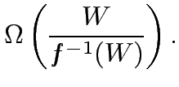

Minimum Cost-Optimal Parallel Time
Let T_{P}^{cost_opt} be the minimum cost-optimal parallel time.
If the isoefficiency function of a parallel system is Θ(f(p)) , then a problem of size W can be solved cost-optimally if and only if
W= Ω(f(p)) .
In other words, for cost optimality, p = O(f⁻⁻¹(W)) .
For cost-optimal systems, T_{P} = Θ(W/p) , therefore,
=

Slide 76
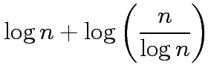

Minimum Cost-Optimal Parallel Time: Example
Consider the problem of adding n numbers.
The isoefficiency function f(p) of this parallel system is Θ(p log p).
If W=n=f(p)=p log p, than log n= log p+ loglog p, than
log n ≈ log p we have
p = f⁻⁻¹(n)=n/ log p ≈ n /log n .
At this processor count, the parallel runtime is:
=
=
Note that both T_{P}^{min} and T_{P}^{cost_opt} for adding n numbers are Θ(log n). This may not always be the case.

Slide 77
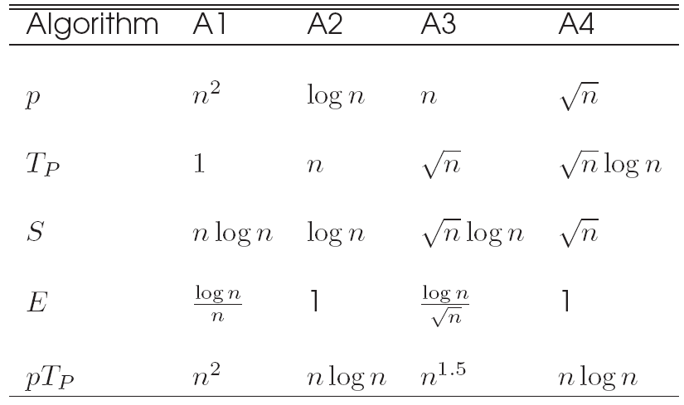
5.6 Asymptotic Analysis of Parallel Programs
Consider the problem of sorting a list of n numbers. The fastest serial programs for this problem run in time Θ(n log n). Consider four parallel algorithms, A1, A2, A3, and A4 as follows:
Comparison of four different algorithms for sorting a given list of numbers. The table shows number of processing elements, parallel runtime, speedup, efficiency and the pT_{P} product.

Slide 78
Asymptotic Analysis of Parallel Programs
If the metric is speed, algorithm A1 is the best, followed by A3, A4, and A2 (in order of increasing T_{P}).
In terms of efficiency, A2 and A4 are the best, followed by A3 and A1.
In terms of cost, algorithms A2 and A4 are cost optimal, A1 and A3 are not.
It is important to identify the objectives of analysis and to use appropriate metrics!

Slide 79
5.7 Other Scalability Metrics
A number of other metrics have been proposed, dictated by specific needs of applications.
For real-time applications, the objective is to scale up a system to accomplish a task in a specified time bound.
In memory constrained environments, metrics operate at the limit of memory and estimate performance under this problem growth rate.

Slide 80
Other Scalability Metrics: Scaled Speedup
Speedup obtained when the problem size is increased linearly with the number of processing elements.
If scaled speedup is close to linear, the system is considered scalable.
If the isoefficiency is near linear, scaled speedup curve is close to linear as well.
If the aggregate memory grows linearly in p, scaled speedup increases problem size to fill memory.
Alternately, the size of the problem is increased subject to an upper-bound on parallel execution time.

Slide 81
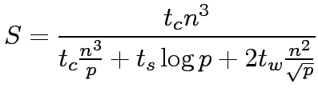
Scaled Speedup: Example
The serial runtime of multiplying a matrix of dimension n x n with a vector is t_{c}n² .
For a given parallel algorithm,
Total memory requirement of this algorithm is Θ(n²) .

Slide 82


Scaled Speedup: Example (continued)
Consider the case of memory-constrained scaling.
We have m= Θ(n²) = Θ(p).
Memory constrained scaled speedup is given by
This is not a particularly scalable system

Slide 83
Scaled Speedup: Example (continued)
Consider the case of time-constrained scaling.
We have T_{P} = O(n²) .
Since this is constrained to be constant, n²= O(p) .
Note that in this case, time-constrained speedup is identical to memory constrained speedup.
This is not surprising, since the memory and time complexity of the operation are identical.

Slide 84
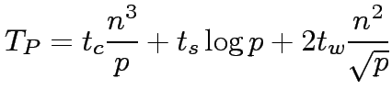
Scaled Speedup: Example
The serial runtime of multiplying two matrices of dimension n x n is t_{c}n³.
The parallel runtime of a given algorithm is:
The speedup S is given by:

Slide 85
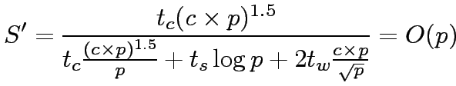
Scaled Speedup: Example (continued)
Consider memory-constrained scaled speedup.
We have memory complexity m= Θ(n²) = Θ(p), or n²=c x p .
At this growth rate, scaled speedup S’ is given by:
Note that this is scalable.

Slide 86
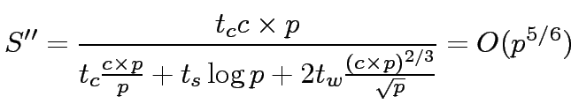
Scaled Speedup: Example (continued)
Consider time-constrained scaled speedup.
We have T_{P} = O(1) = O(n³ / p) , or n³=c x p .
Time-constrained speedup S’’ is given by:
Memory constrained scaling yields better performance.

Slide 87

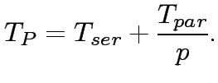
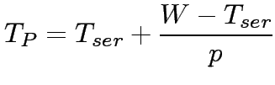
Serial Fraction f
If the serial runtime of a computation can be divided into a totally parallel and a totally serial component, we have:
From this, we have,

Slide 88
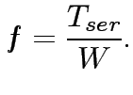
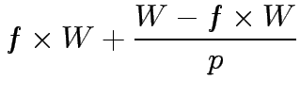

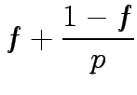
Serial Fraction f
The serial fraction f of a parallel program is defined as:
Therefore, we have:

Slide 89
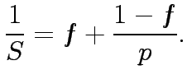
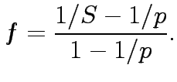
Serial Fraction
Since S = W / T_{P} , we have
From this, we have:
If f increases with the number of processors, this is an indicator of rising overhead, and thus an indicator of poor scalability.

Slide 90




Serial Fraction: Example
Consider the problem of serial component of the matrix-vector product.
We have:
Here, the denominator is the serial runtime and the numerator is the overhead.

